Slide 1
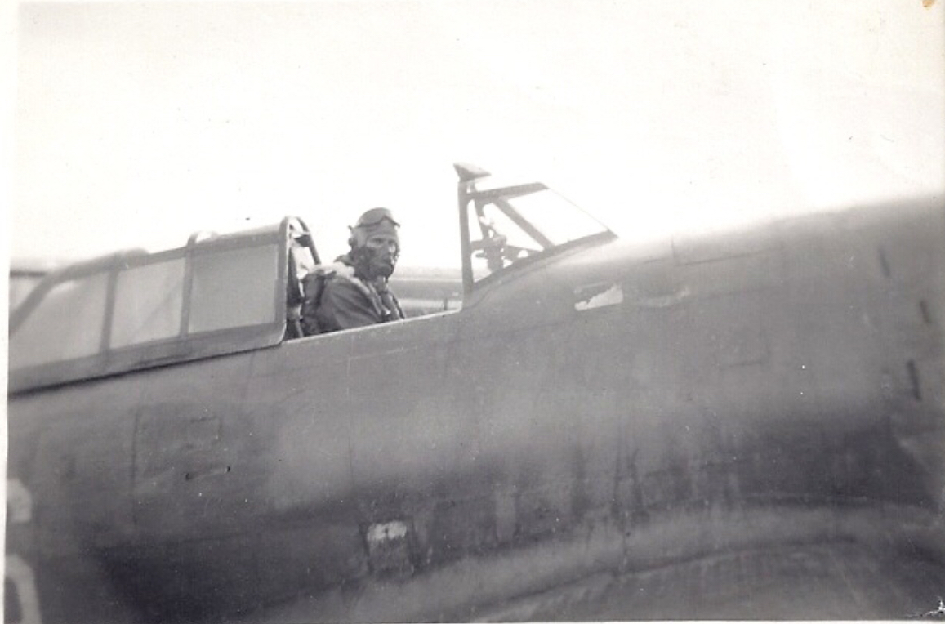
Y-29 Asch
Edward E. Downs
March 1, 1945 - 2020
Advanced Landing Ground Y-29
Zutendaal
November 2, 1944 – July 16, 1945
Jan Lantmeeters
Notes:
A short history of Y-29 and Edward Downs.

Slide 2
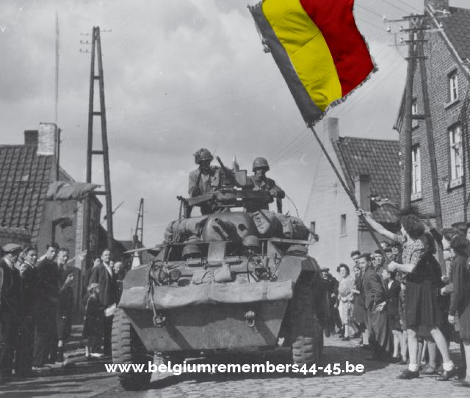
September 14, 1944
Liberation Zutendaal
Notes:
September 14, 1944: the liberation of Zutendaal.
The war was not yet over.

Slide 3
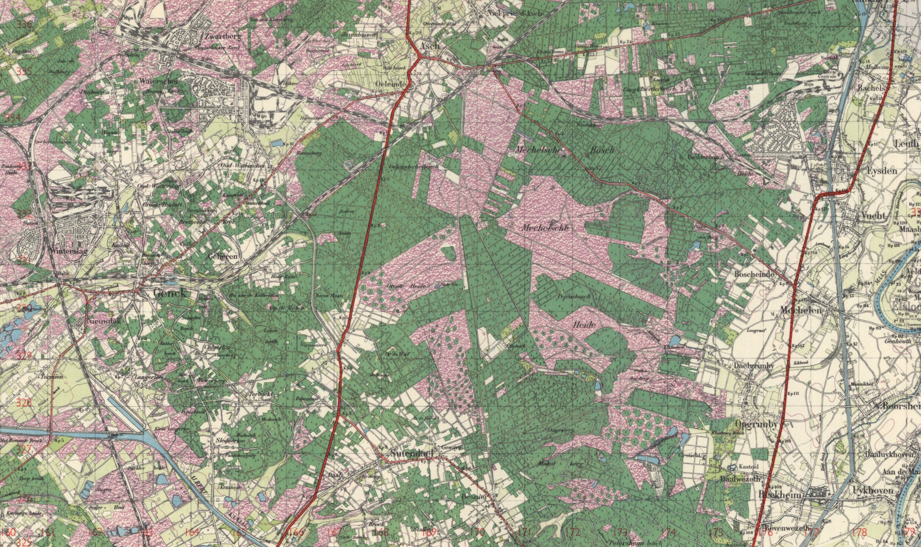
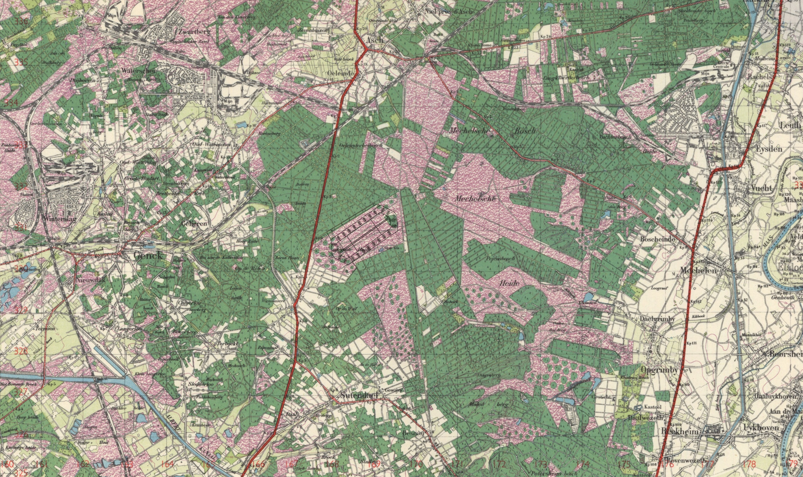
Notes:
The Allies needed an Advanced Landing Ground close to the front.
A heath area was found in Zutendaal.

Slide 4
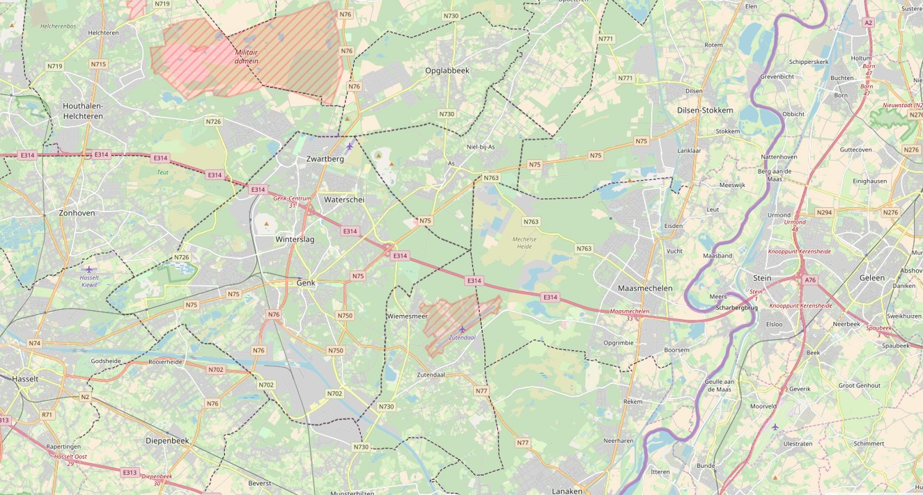
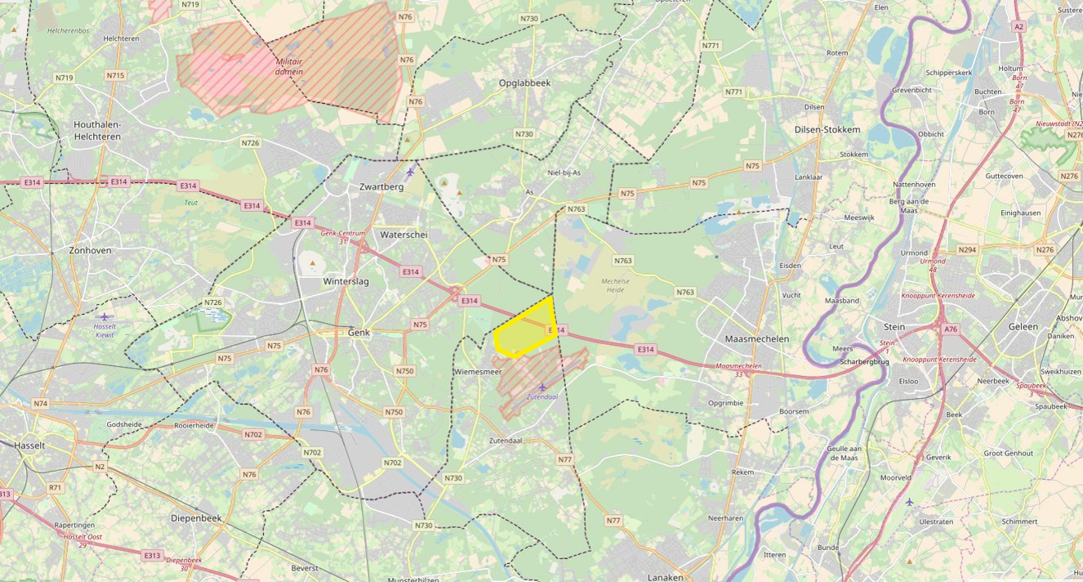
Y-29
Asch
Notes:
The Y-29 was located the closest to the village As so they called it Y-29 Asch (old spelling of As).

Slide 5
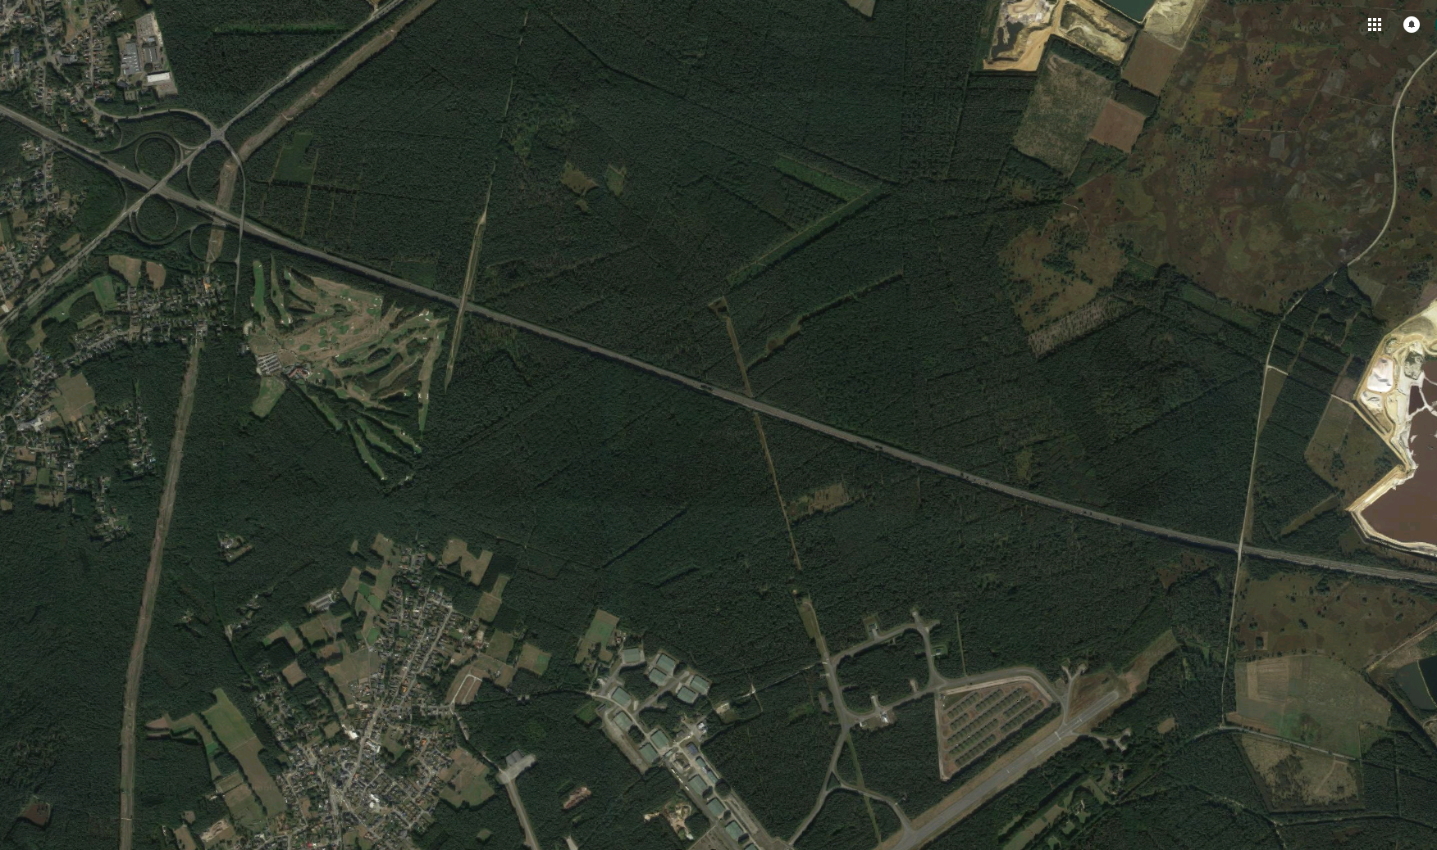
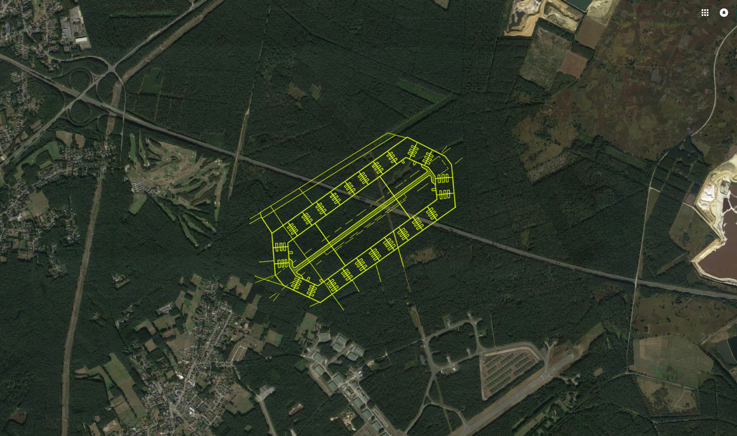
Runway: 1.5 kilometers (5000 ft)
Parking place: 150 airplanes
Notes:
This is an actual satellite image of the area. The motorway from the Netherlands (right) to Brussels/Antwerp (left).
Here were are now.
Runway of 1.5 kilometers (5000 feet)
Parking spaces for 150 aircraft

Slide 6
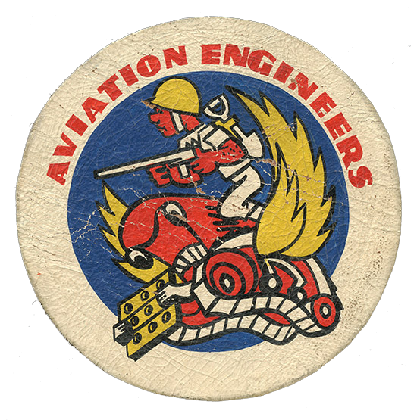
852 Engineer Aviation Battalion
November 5, 1945 – November 26, 1945
Notes:
Y-29 was built by the 852 Engineer Aviation Battalion in three weeks.

Slide 7
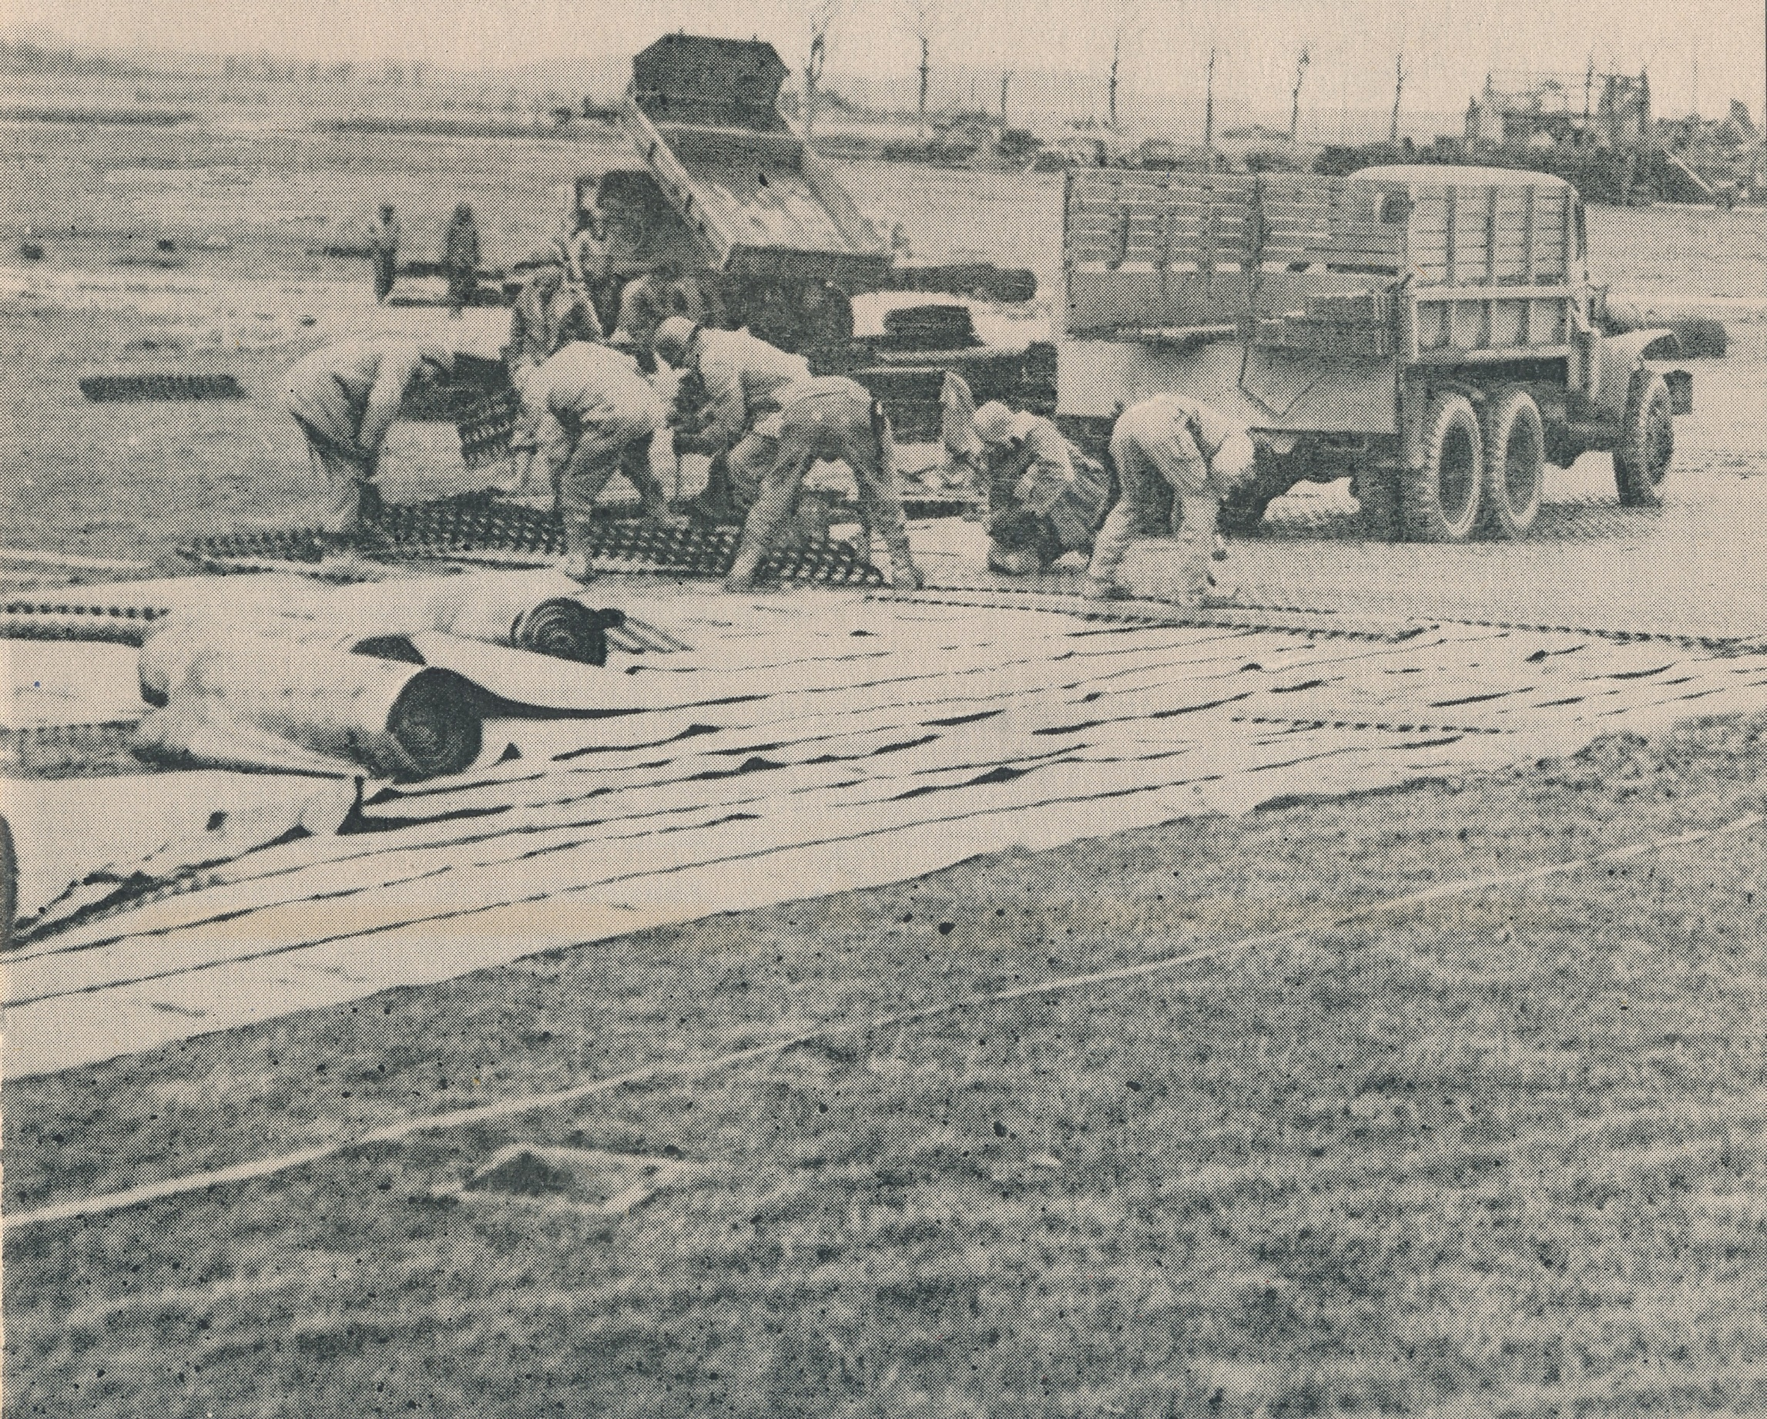
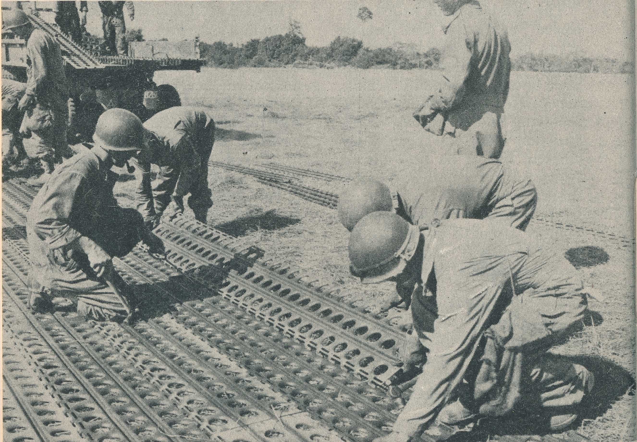
Pierced Steel Planking (PSP)
Notes:
The runway was made of Pierced Steel Planking (PSP) plates.

Slide 8
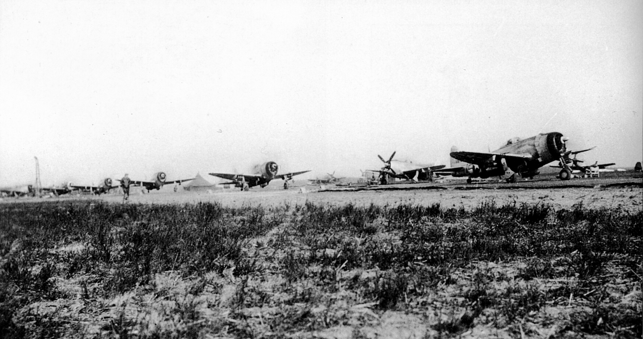
366 Fighter Group
November 26, 1944 – April 11, 1945
Notes:
On November 26, 1944 the 366th Fighter Group lands at the Y-29.
A Fighter Group consists of about 1000 men, including 145 pilots and 75 aircraft.

Slide 9
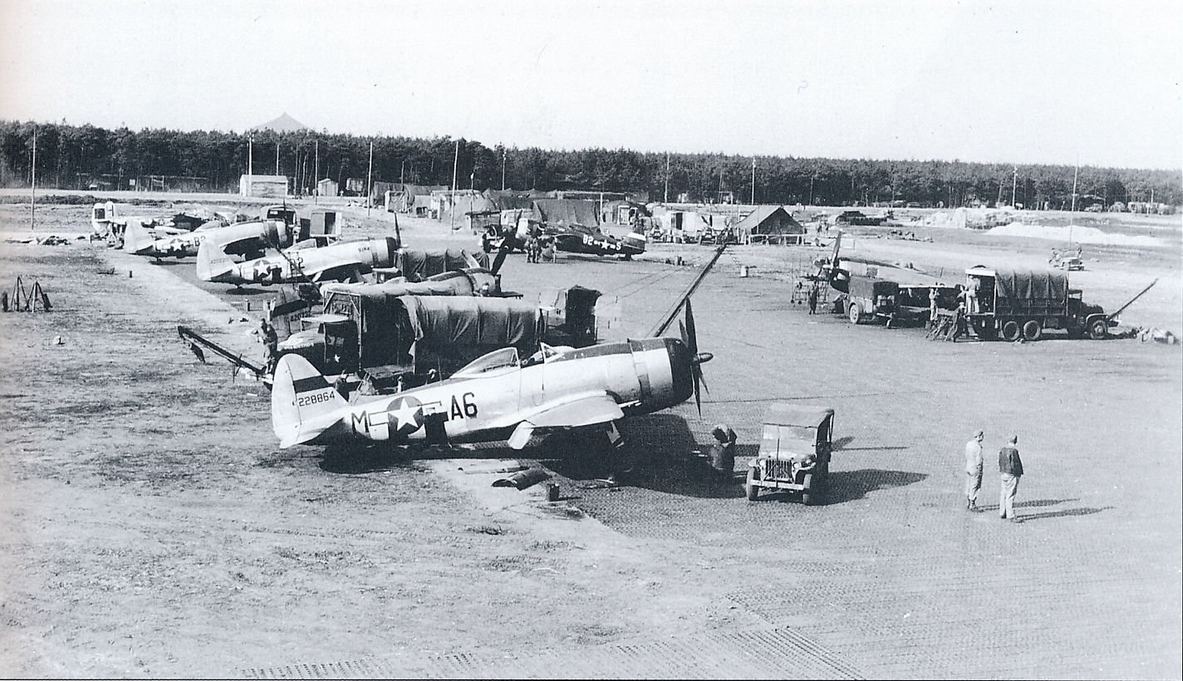
Notes:
The airplane: Republic P-47 Thunderbolt fighter-bomber.
View of the great plain, no buildings, no hangars. Everything is outside, just a few tents.
In the distance the slag heap of coalmine Waterschei, where the pilots could take a warm shower.

Slide 10
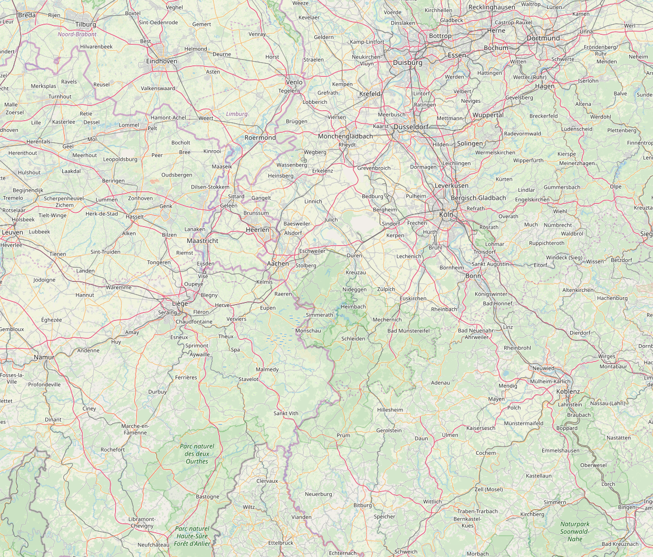
Y-29
Hürtgenwald
Notes:
The purpose of the flights from Y-29 was the Hürtgenwald, east of Aachen.
In that neighborhood were several dams that supplied electricity to the industry in the Ruhr area.

Slide 11
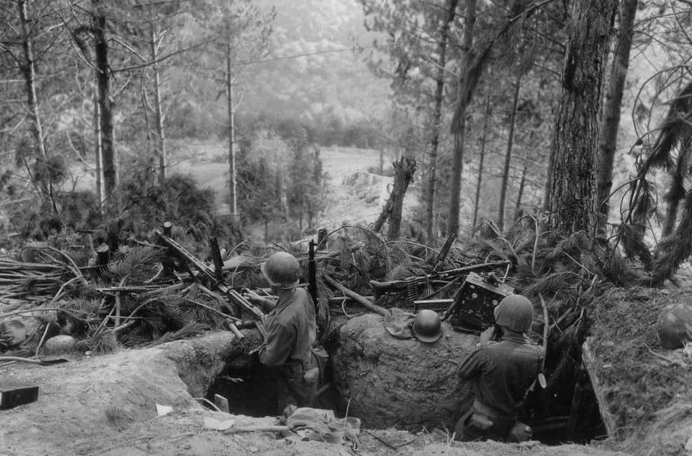
Notes:
In the Hürtgenwald there was the Siegriedlinie or West Wall.
It was a very fierce battle with 33,000 American and 29,000 German casualties.
A forgotten history.

Slide 12
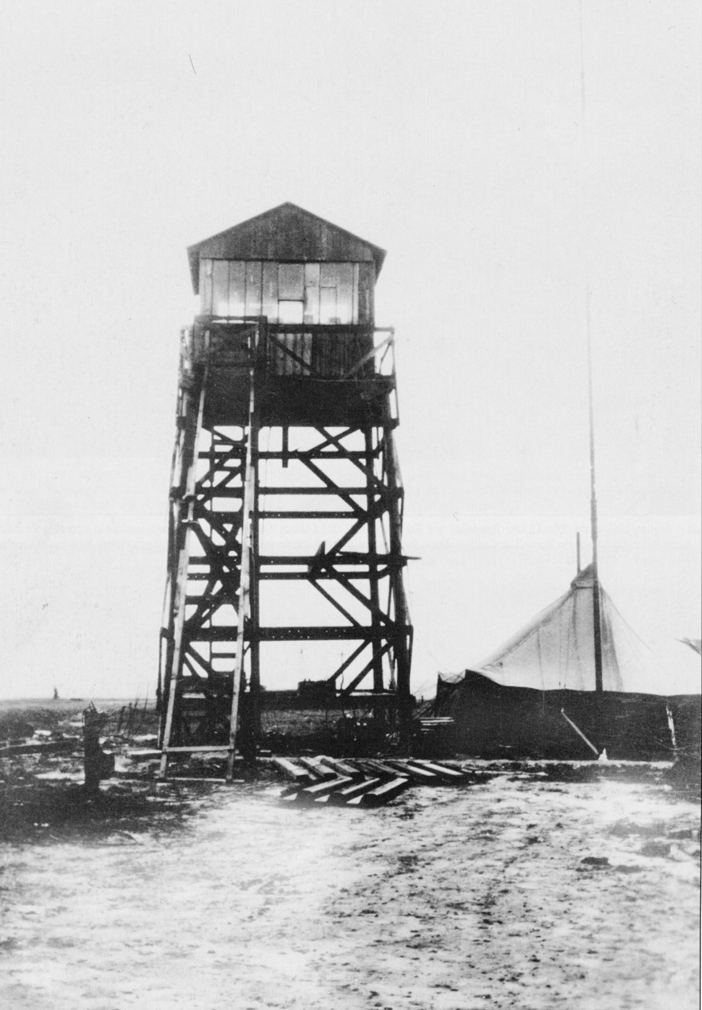
Notes:
Back to the Y-29: the control tower at the airfield.

Slide 13
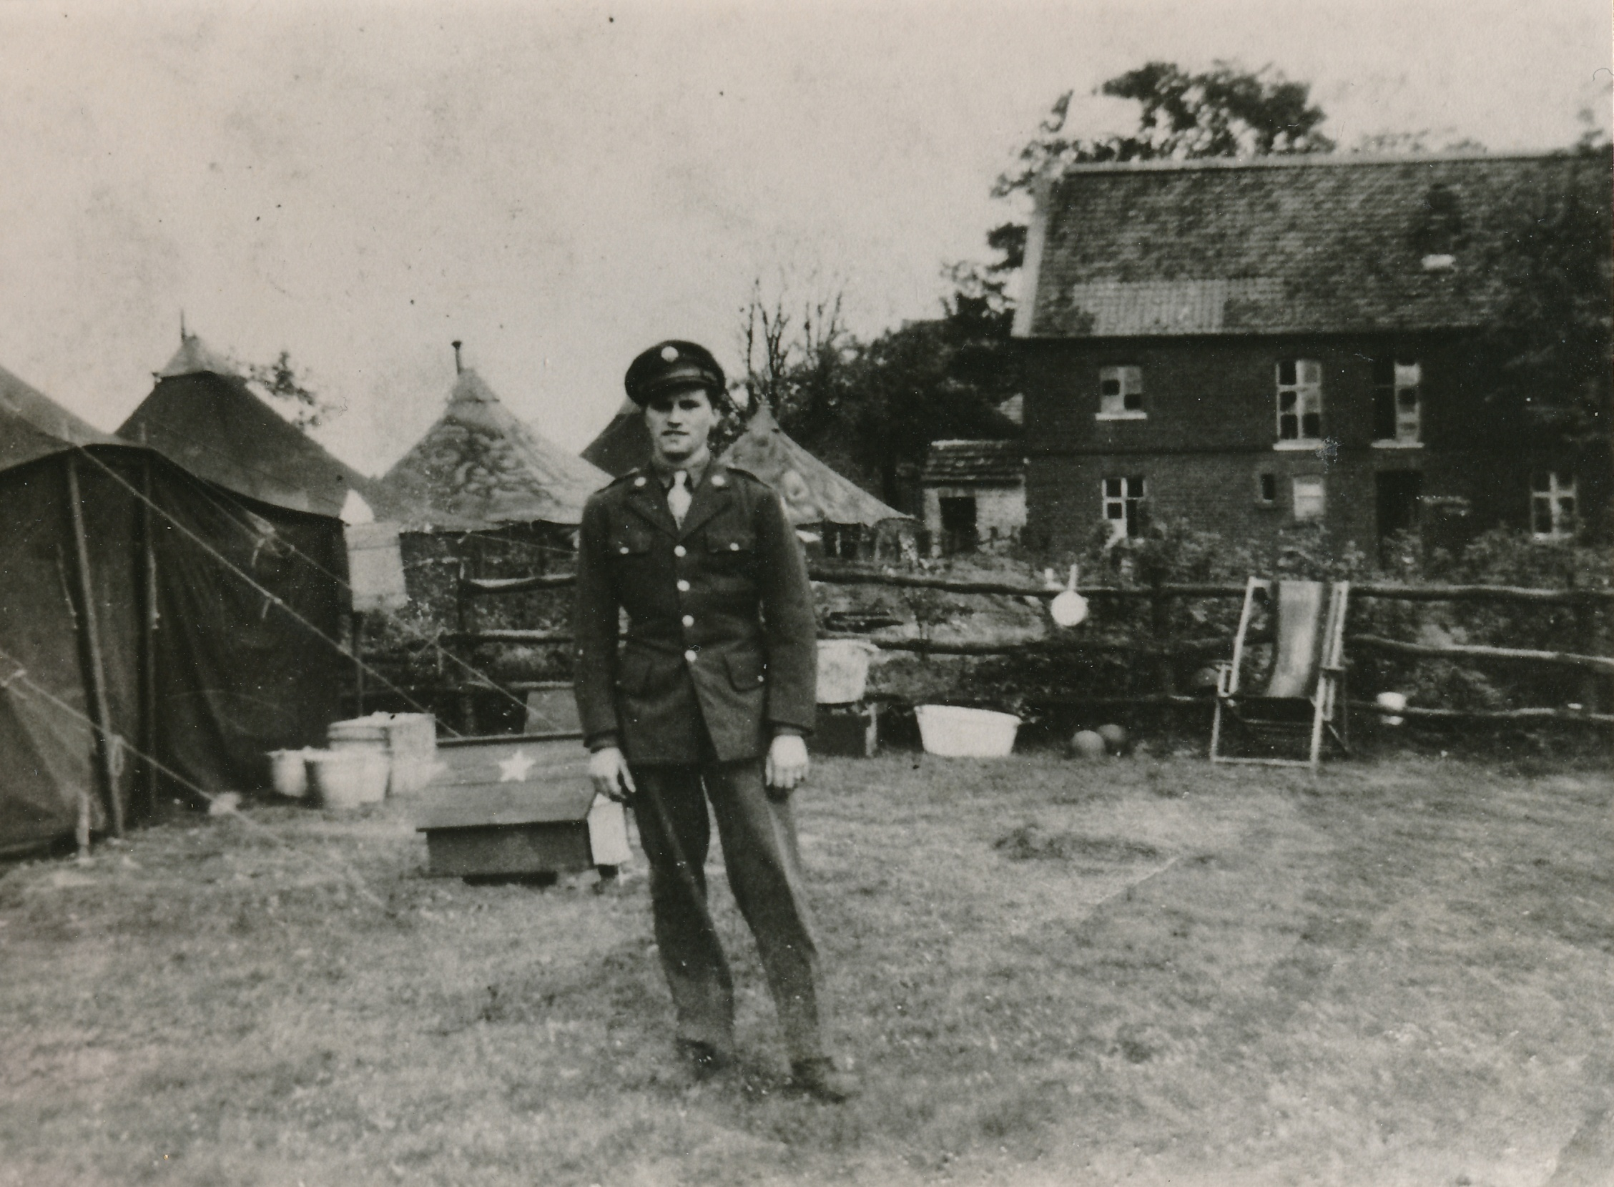
Notes:
The living conditions at the airfield were very primitive. Most of the men slept in tents. The officers slept in the elementary school of Zutendaal and As or by the locals.

Slide 14
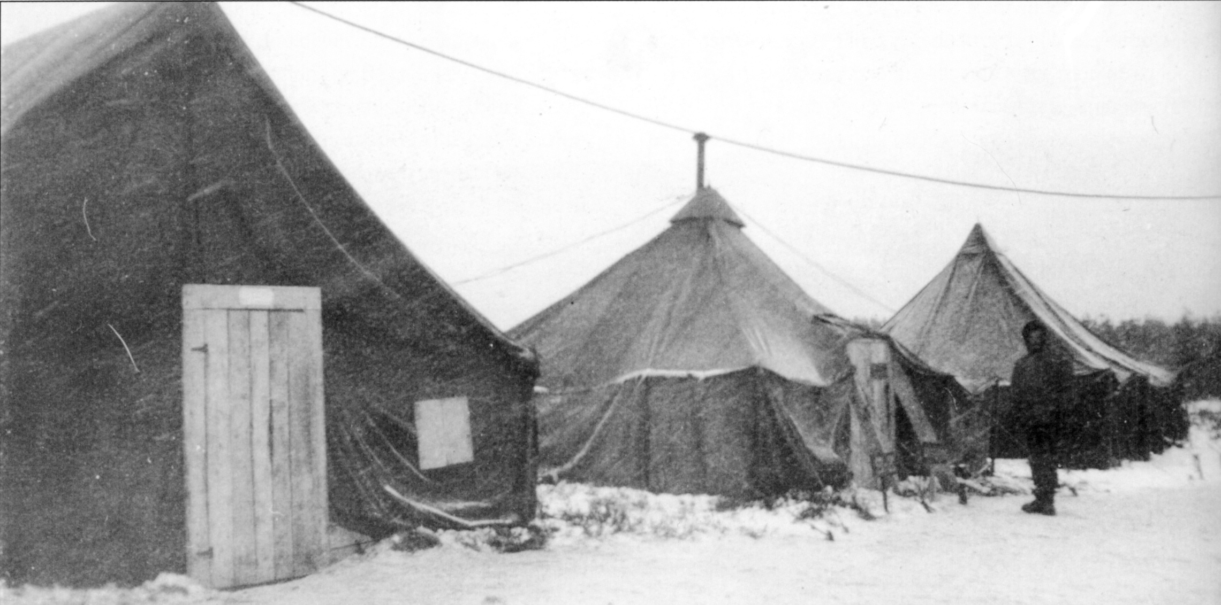
Notes:
The winter of 1944 was one of the worst winters in years.

Slide 15
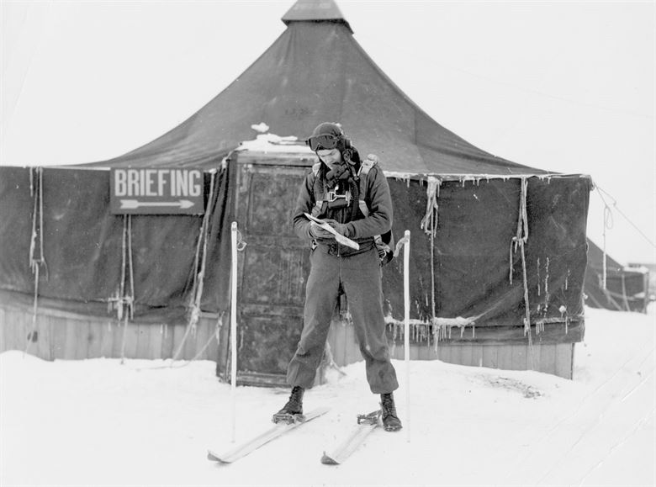

Slide 16
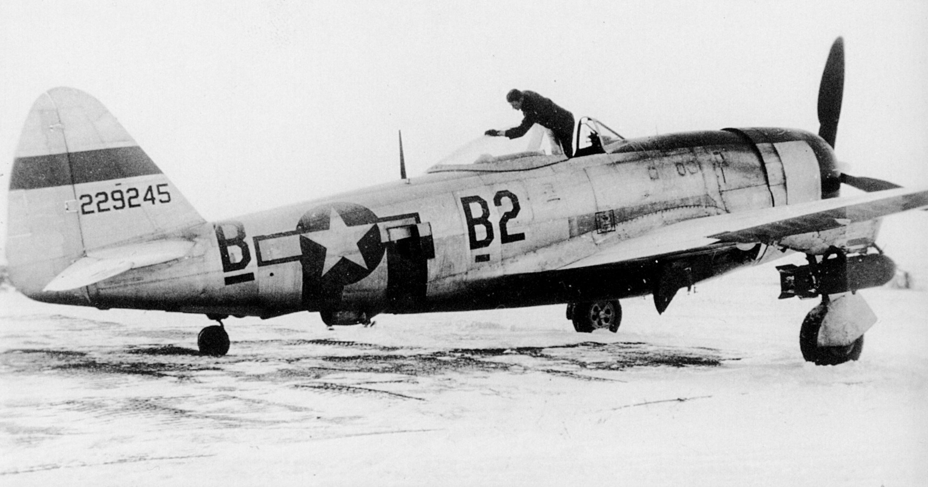
Notes:
It was very difficult to keep the planes operational every day.
Due to the poor weather there were many days of no flying.

Slide 17
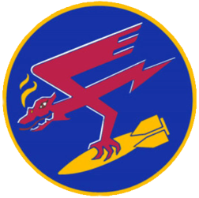
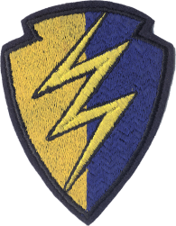
Edward A. Downs
September 1942:
Enlisted in the Air Forces
May 1944:
Pilot’s Wings
December 1944:
Overseas
December 1944:
Y-29 Asch (with 30 other new pilots)
389 Fighter Squadron / 366 Fighter Group
Training
January 1945:
Training
February 1945
Training
Notes:
In December 1944, Edward Downs came at Y-29 (with 30 other new pilots)

Slide 18
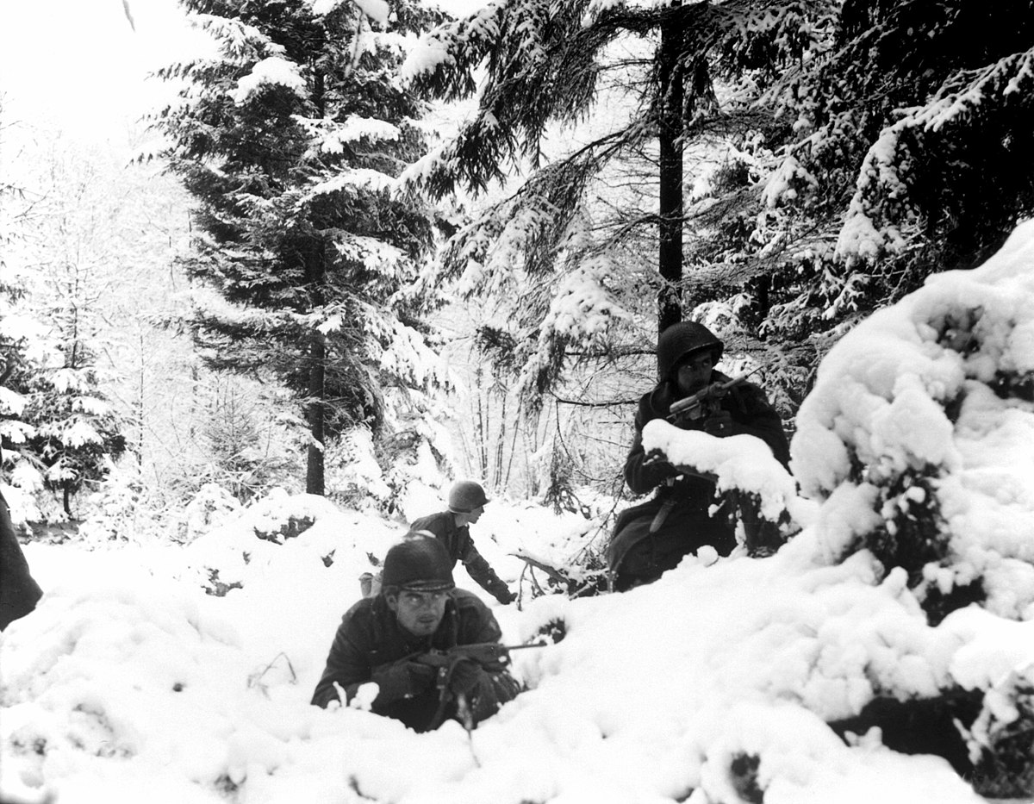
Battle of the Bulge – Ardennes – December, 16 1944 – January 25, 1945
Notes:
December 16, 1944: beginning of the Battle of the Bulge – Ardennes
More than 40,000 Allied soldiers and 33,000 German soldiers were killed

Slide 19
Y-29
Hürtgenwald
Ardennes
December 16, 1944
January 25, 1945
Notes:
The purpose of the flights shifted from the Hürtgenwald to the Ardennes.

Slide 20
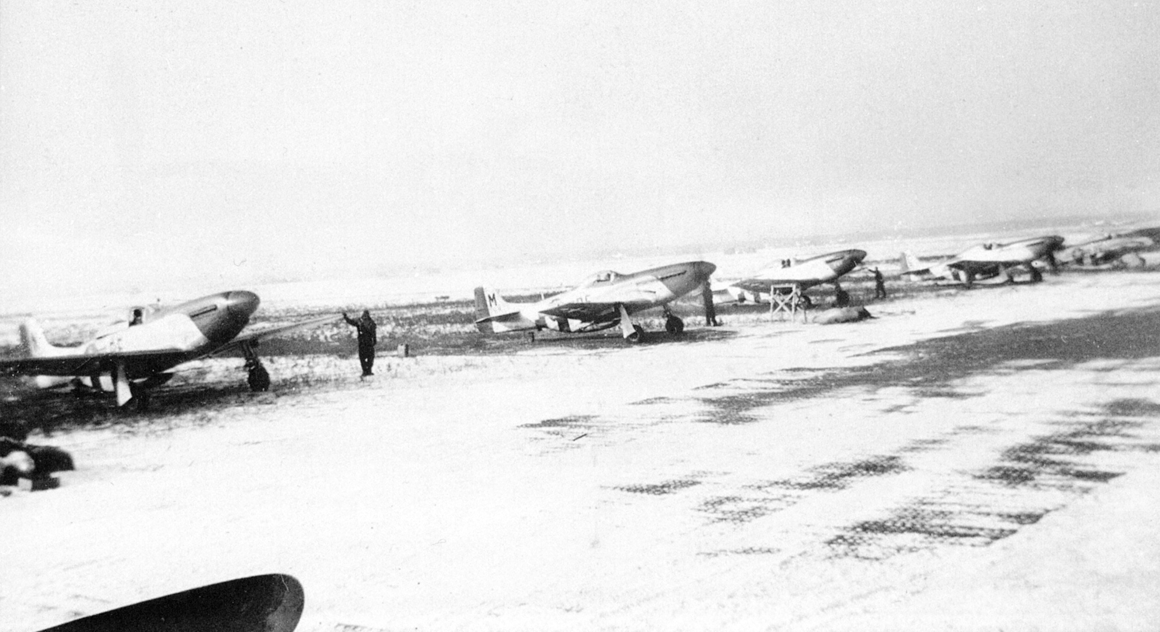
352 Fighter Group
December 23, 1944 - Januari 27, 1945
Notes:
The 352nd Fighter Group arrived to help from Bodney in England.

Slide 21
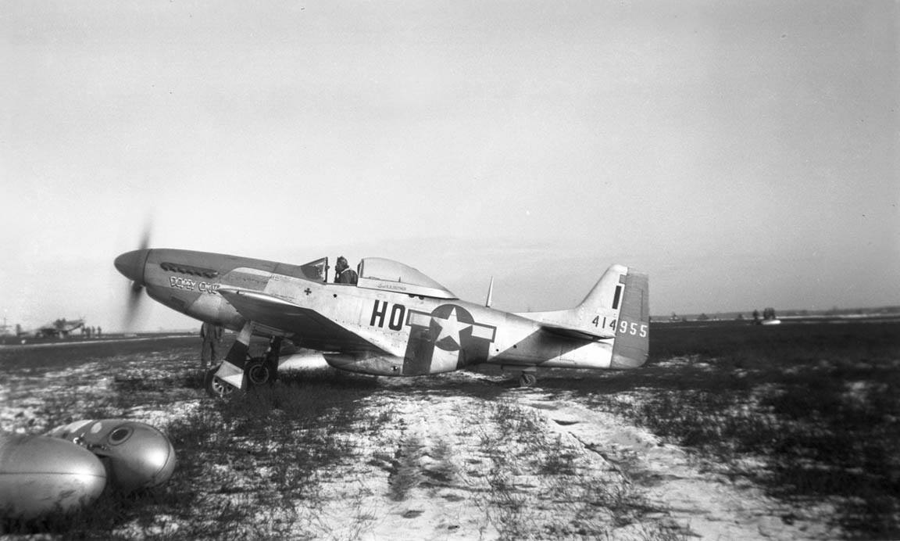
Notes:
The airplanes were the P-51 Mustang fighters.
They called themselves the Bleunosed Bastards of Bodney.

Slide 22
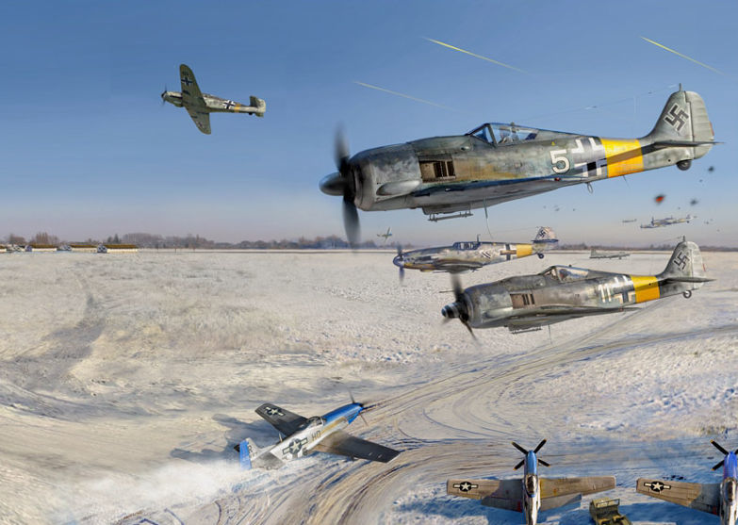
January 1, 1945
Operation Bodenplatte
Notes:
January 1, 1945. Operation Bodenplatte was a simultaneous German air raid on 20 Allied airfields with 800 German planes in France, Luxembourg, the Netherlands and Belgium. Purpose: destroying as many Allied aircraft on the ground – so the Allied aircrafts could not fly over the Ardennes. The Germans hoped that everyone was drunk in his bed after the 1st New Year in Europe.

Slide 23
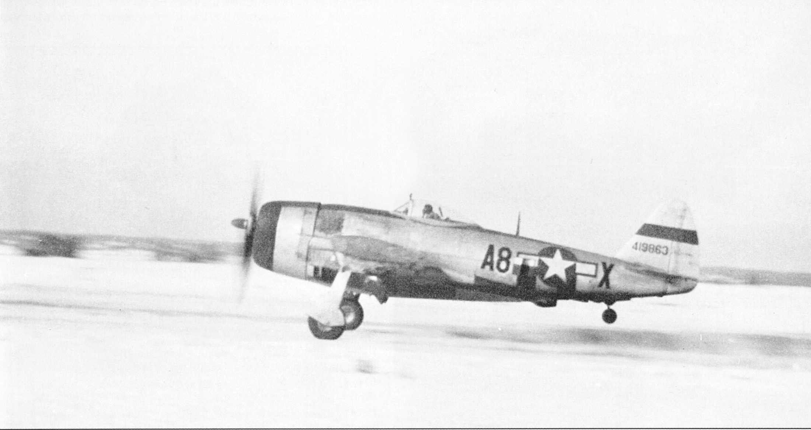
9:16 – take off of 8 P-47 Thunderbolts + 12 P-51 Mustangs ready to take off
Notes:
4 minutes before the German attack, at 9:16, 8 P-47 Thunderbolts were taking off for a mission over the Ardennes.
At the same time 12 P-51 Mustangs were ready to take off after the Thunderbolts for a mission over the front.
One of the pilots suddenly saw 61 German planes coming to the Y-29.

Slide 24
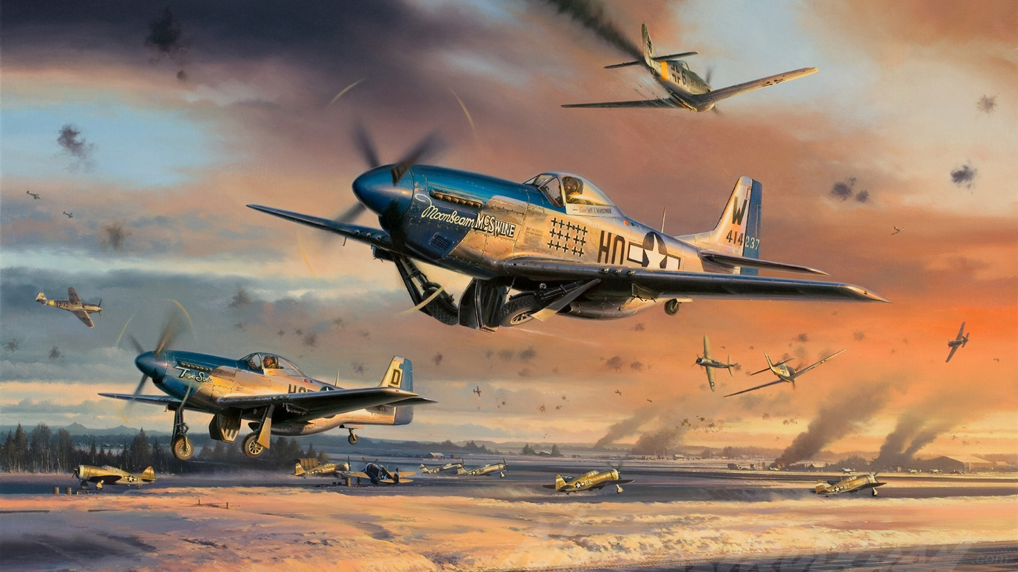
Notes:
The Thunderbolts immediately attacked the German fighters. The Mustangs all took off and attacked also the German fighters.

Slide 25
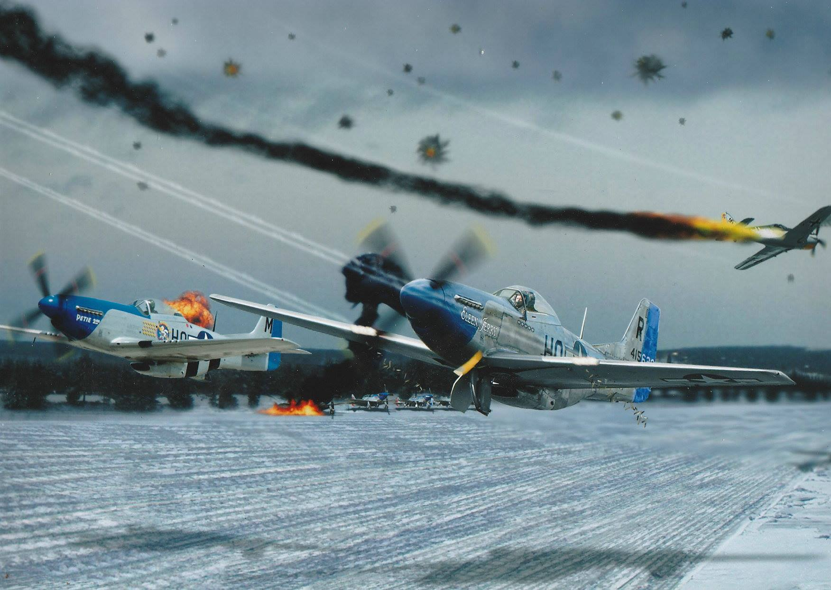
52 German airplanes were shot down or damaged
17 German pilots were killed
1 American airplane was shot down and 3 damaged
4 American soldiers were hurt
Notes:
A great dogfight took place over the Y-29.
Nowhere the German losses were as high as above the Y-29.
In America this dogfight was named: “The Legend of the Y-29”
52 German airplanes were shot down or damaged
17 German pilots were killed
1 American airplane was shot down – the pilot bailed out and landed safely
and 3 American airplanes were damaged
4 American soldiers were hurt

Slide 26
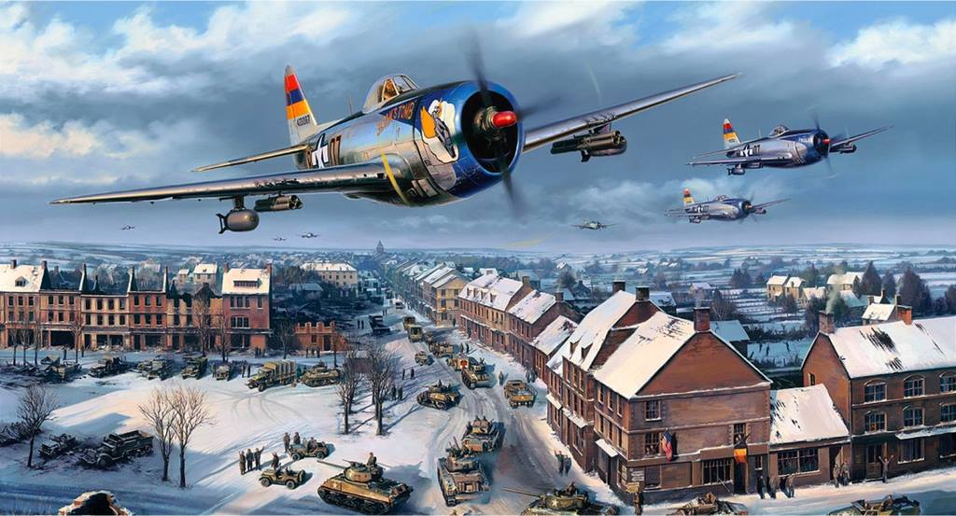
January 25, 1945
The end of the Battle of the Bulge - Ardennes
Notes:
January 25, 1945: The end of the Battle of the Bulge - Ardennes

Slide 27
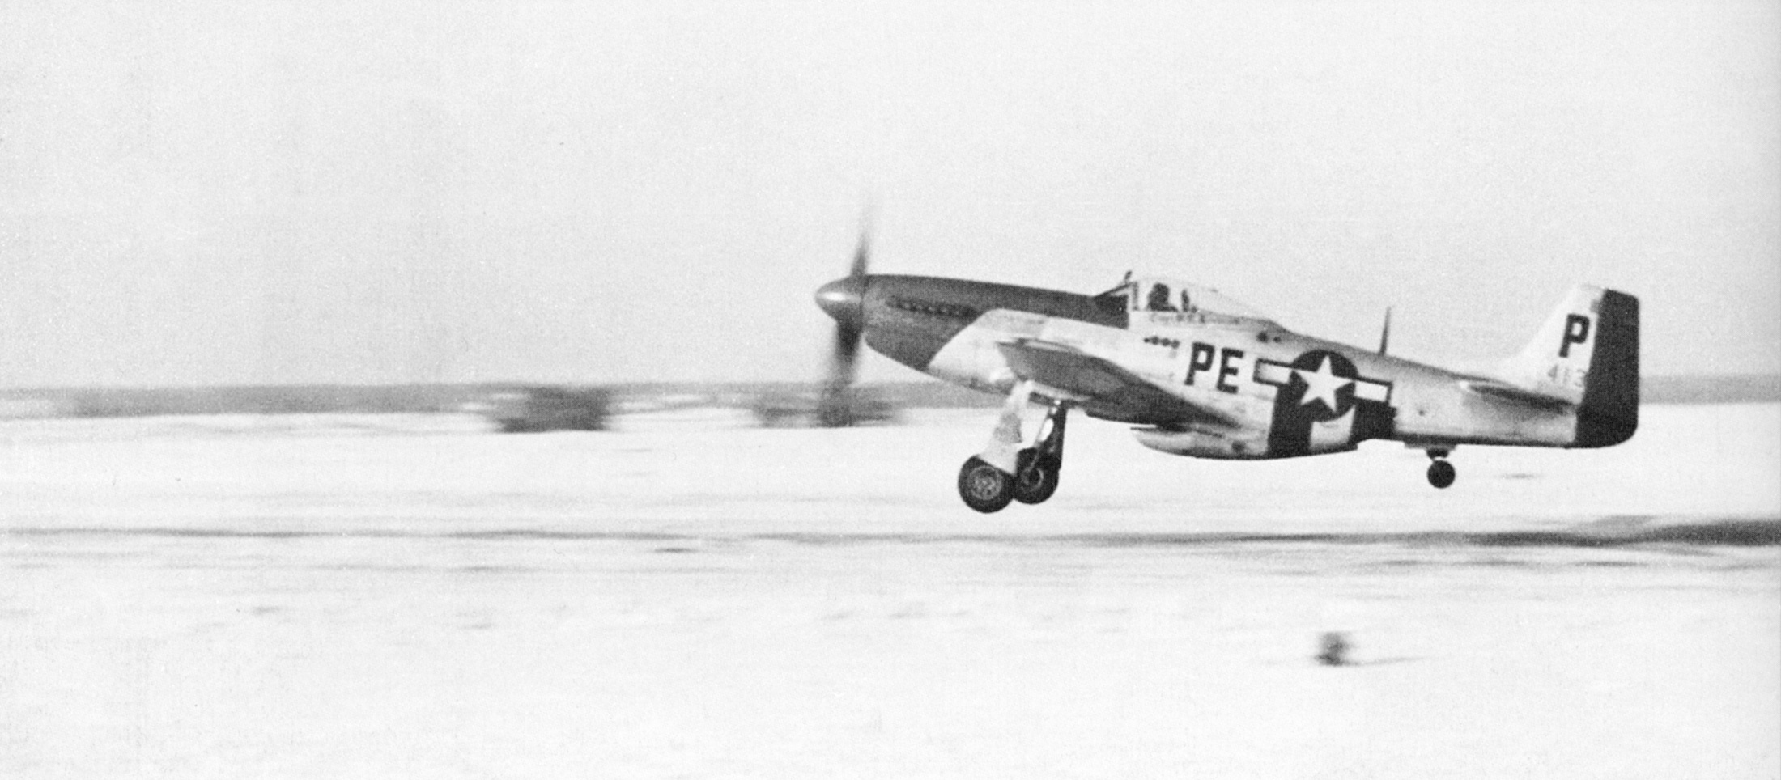
January 27, 1945
352 Fighter Group to A-84 Chievres (Belgium)
Notes:
After the Battle of the Bulge, the P-51 Mustangs leaves theY-29

Slide 28
Y-29
Hürtgenwald
Ardennen
January 25, 1945
Notes:
The purpose of the flights shifted from the Ardennes back to the Hürtgenwald.

Slide 29
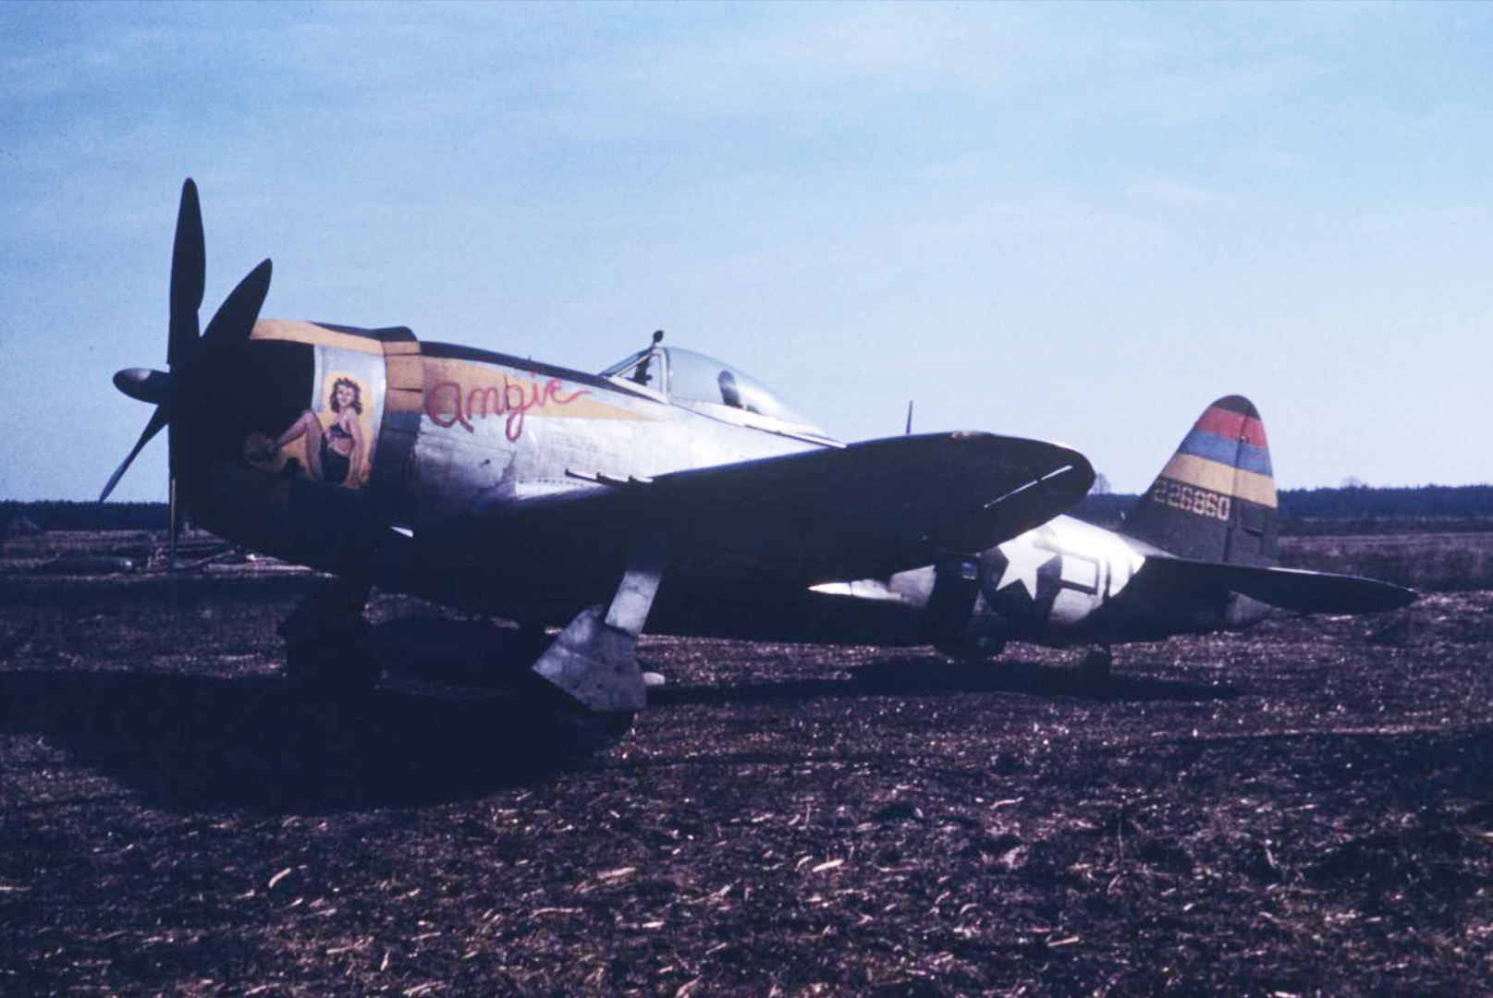
406 Fighter Group
February 8, 1945 – April 15, 1945
Notes:
February 8, 1945 the 406th Fighter Group came to Y-29.
There were now 2 fighter groups on Y-29. This means more than 2000 men and 150 airplanes.

Slide 30
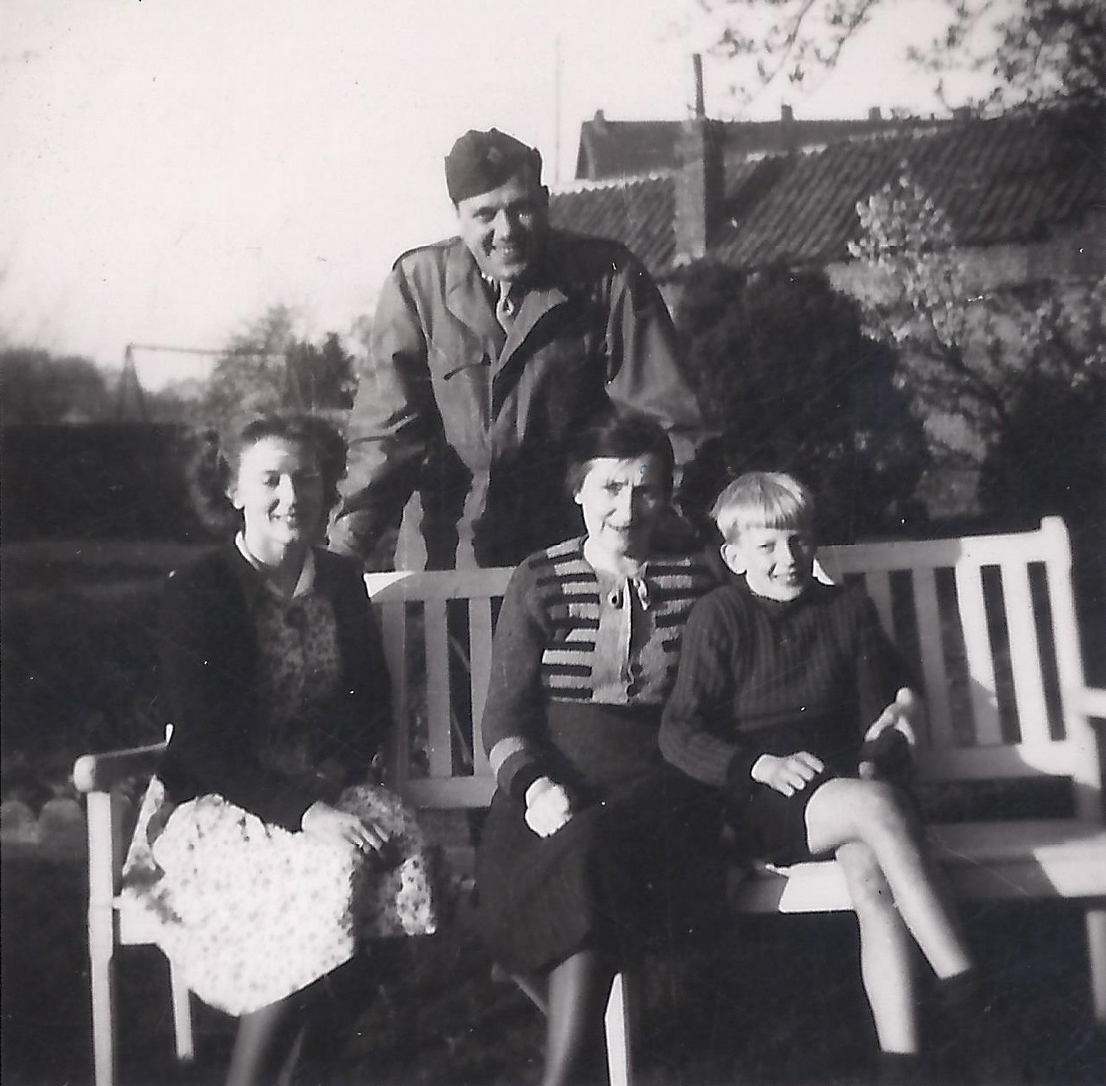
Notes:
Wooden chalets were built and many officers were sleeping by the locals in As, Zutendaal and Genk.
An American pilot at his host family in Genk. In the middle is my grandmother (Maria Lantmeeters-Reynders), my aunt (Elsa Lantmeeters) left, and right my father (Jos Lantmeeters), then 12 years old.

Slide 31
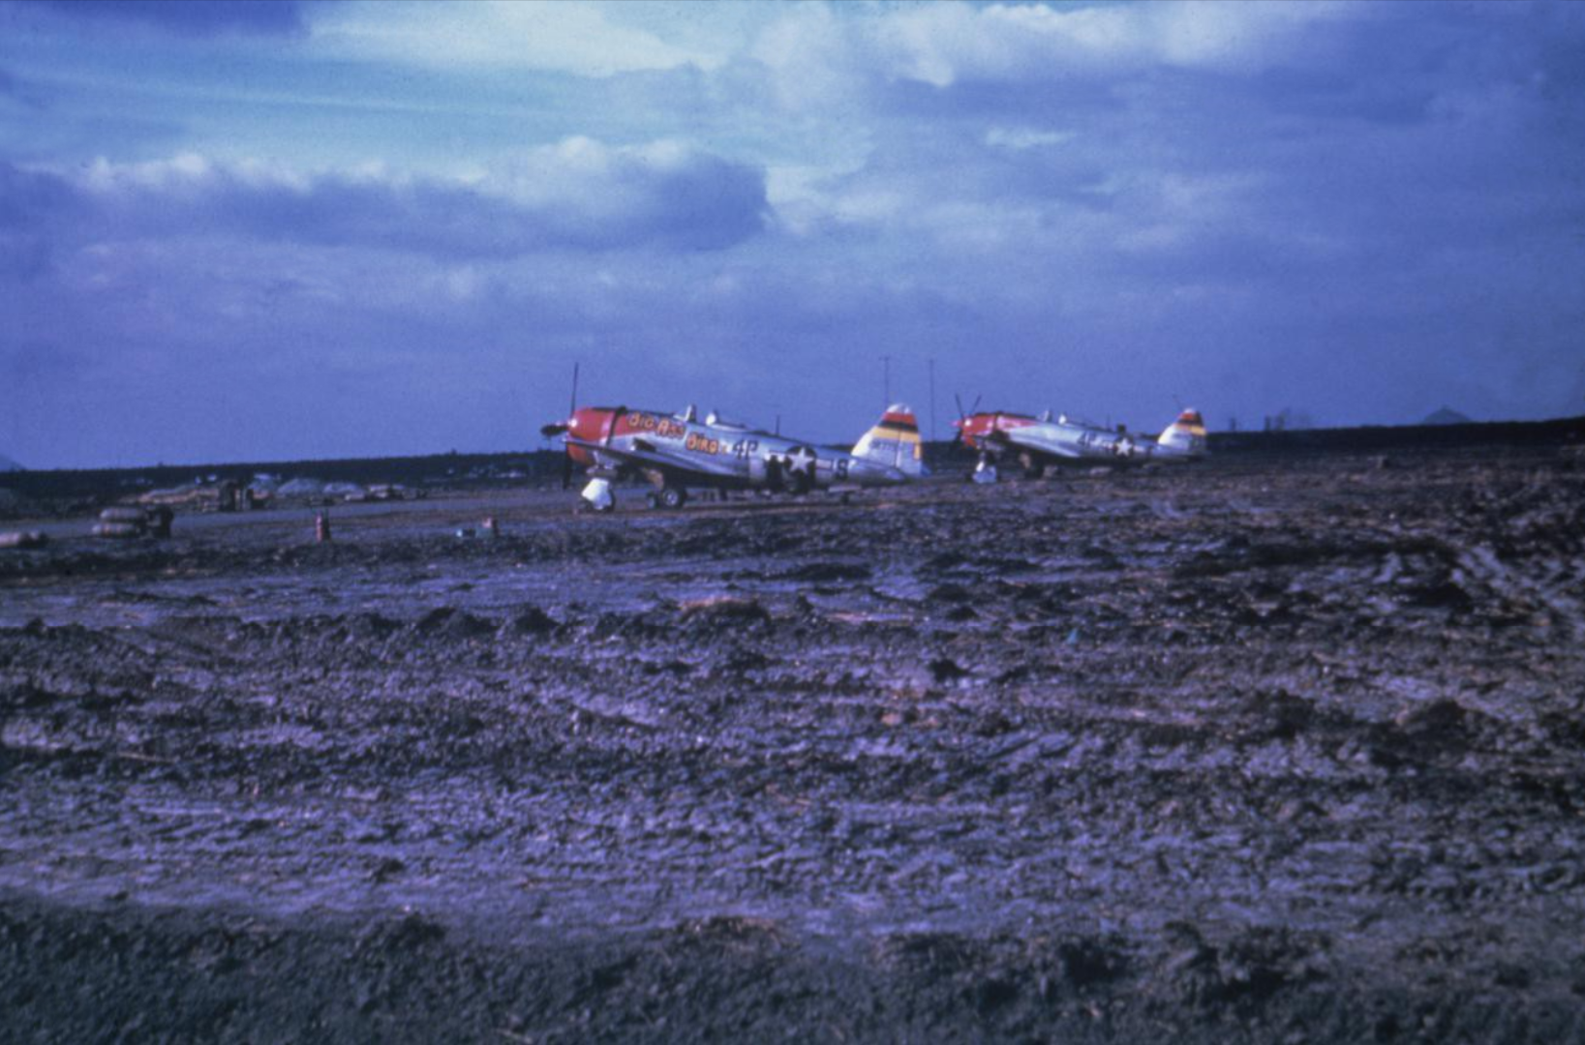
Notes:
A new problem: Mud by the melting of the snow.

Slide 32
Battle of the Rhine
February 11, 1945 – March 15, 1945
Y-29
Hürtgenwald
February 10, 1945
Notes:
After the end of the Battle of the Hürtgenwald there was the Battle of the Rhine.

Slide 33
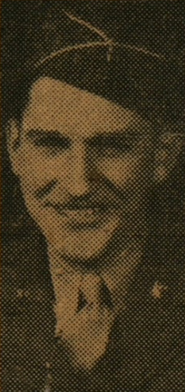
Edward A. Downs
February 21, 1945
visit from his brother Corporal Robert S. Downs
1st mission February 22, 1945 – 13:00-15:57
Bomber escort mission follow-up dive-bombing (Germany)
2nd mission February 22, 1945 – 16:37-18:01
Armed recce in the area of Dusseldorf, Elberfeld, Bonn (Germany)
Robert S. Downs
Notes:
February 21, 1945
visit at the Y-29 from his brother Corporal Robert Downs
Edward was flying his first two mission on February 22, 1945

Slide 34
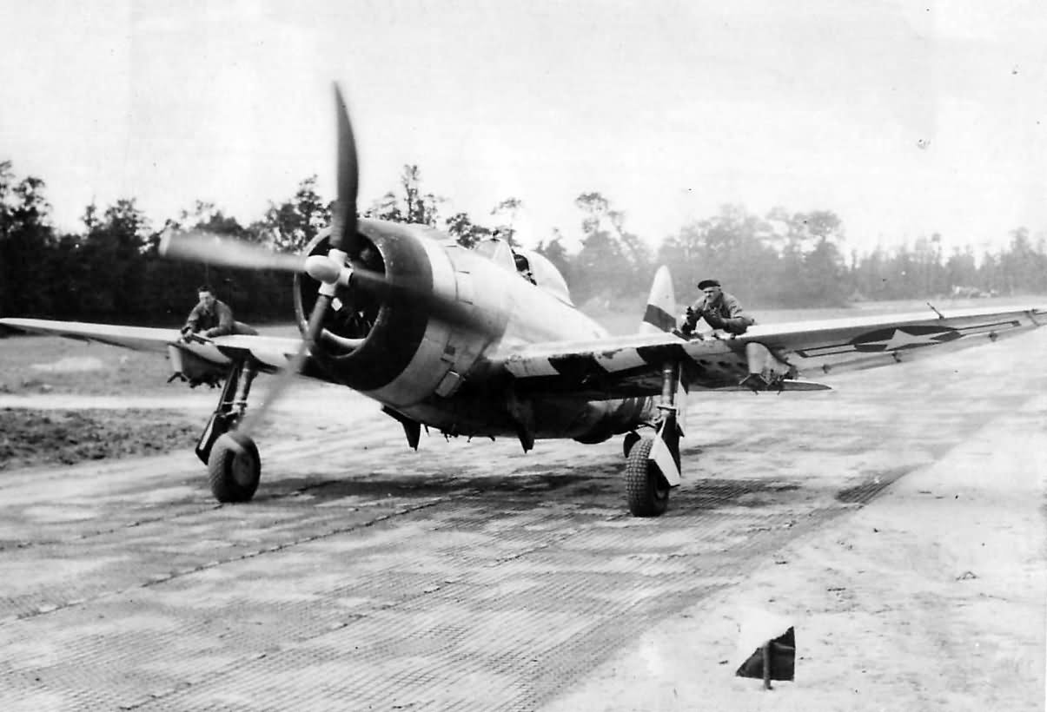
Notes:
Robert rode out to the take-off area on the wing of Edwards plane like on this photo.
This was a normal practice, because the pilot could not see before him. The men on the wing was his guide.

Slide 35
1st mission February 22, 1945
Bomber escort mission follow-up dive-bombing (Germany)
2nd mission February 22, 1945
Armed recce in the area of Dusseldorf, Elberfeld, Bonn (Germany)
3rd – 10th mission February 23-24-25-27, 1945
Armed recces and dive-bombing missions (Germany)
Notes:
The next 8 missions were armed recces and dive bombing missions in the Rhine area.

Slide 36
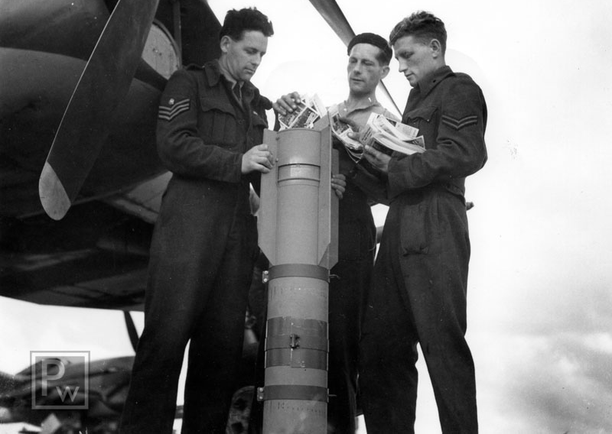
11nd mission March 1, 1945
Leaflet bombing mission
The mission was to drop 24 leaflet bombs, six each on Krefeld and Neuss and the remaining on Mönchengladbach.
Notes:
The 11th mission March 1, 1945
A leaflet bombing mission
The mission was to 24 leaflet bombs, 6 each on Krefeld and Neuss and the remaining on Mönchengladbach.

Slide 37
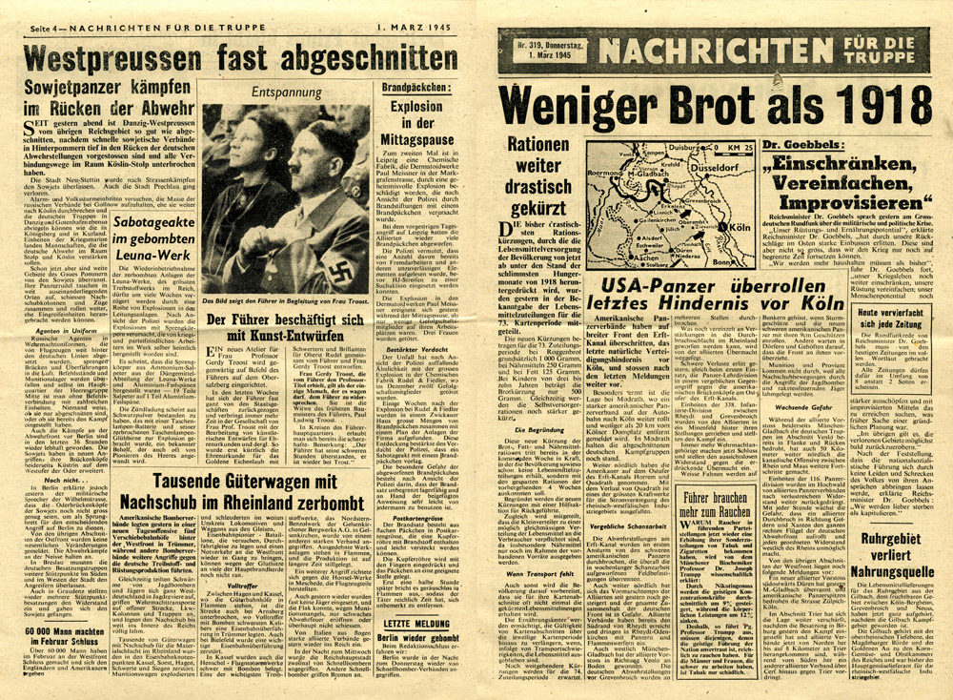
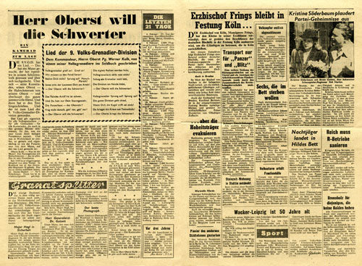
Notes:
This was the leaflet of March 1, 1945.

Slide 38
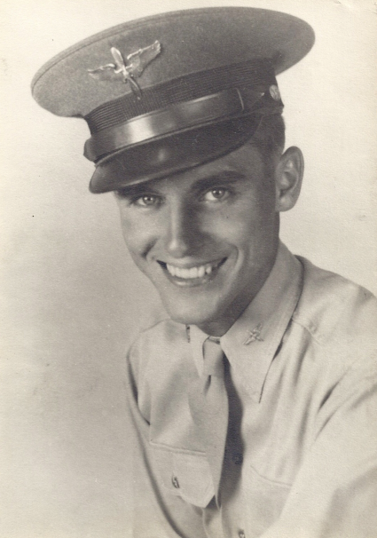
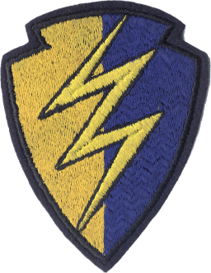
389
Fighter Squadron
366
Fighter
Group
2nd Lieutenant Edward A. Downs
Republic P-47D-28-RE Thunderbolt – 44-19785 – A6-F
Notes:
2nd lieutenant Edward Downs took of in this plane, with the registration A6-F

Slide 39
Y-29
March 1, 1945 – Y-29 Asch
8 P-47 Thunderbolts
08:50 leaving Y-29
09:15 above the target
09:30 attack 18 FW190 and Me109
Notes:
8 P-47 Thunderbolts were leaving Y-29 at 8:50
09:15 they were above the target
09:30 attack by 18 German fighters (FW190 and Me109)

Slide 40
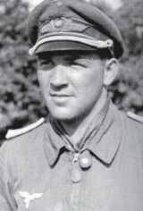
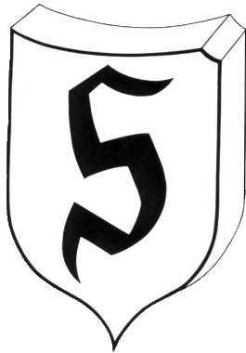
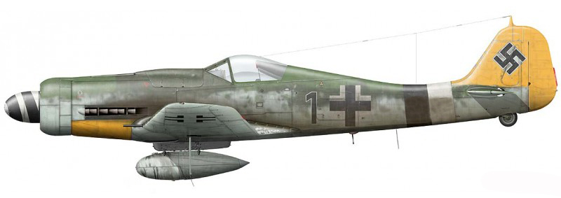
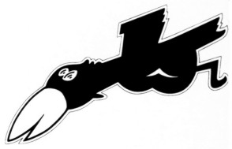
Jagdgruppe 26
Oberleutnant Karl-Wilhelm Hofmann
44 victories
Staffel 5
Focke Wulf FW 190 D-9
Notes:
2nd lieutenant Edward Downs was shot down by Karl-Wilhelm Hofmann.
He was a German Ace with 44 aerial victories in 260 missions.
2nd lieutenant Edward Downs was his 43 victory.
Karl-Wilhelm Hofmann was killed on March 26, 1945.

Slide 41
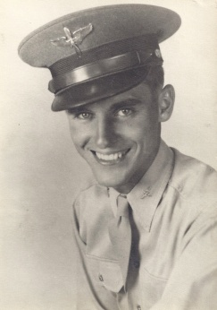
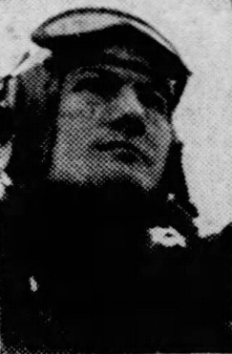
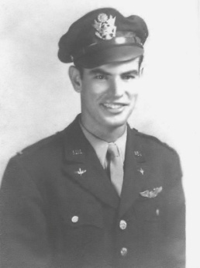
Killed In Action – March 1, 1945
2nd Lieutenant Edward A. Downs
°1916 - +1945
1st Lieutenant Stephen R. Pease
°1923 - +1945
389
Fighter Squadron
366
Fighter
Group
2nd Lieutenant William McCauley
°1922 - +1945
Bailed out – landed safely
1st Lieutenant Joseph A. Kelly
2nd Lieutenant Arthur S. Severson
Notes:
Two more pilots were killed in the same mission.
And two pilots bailed out and landed safely.
Five of the eight airplanes didn’t come back to the Y-29.

Slide 42
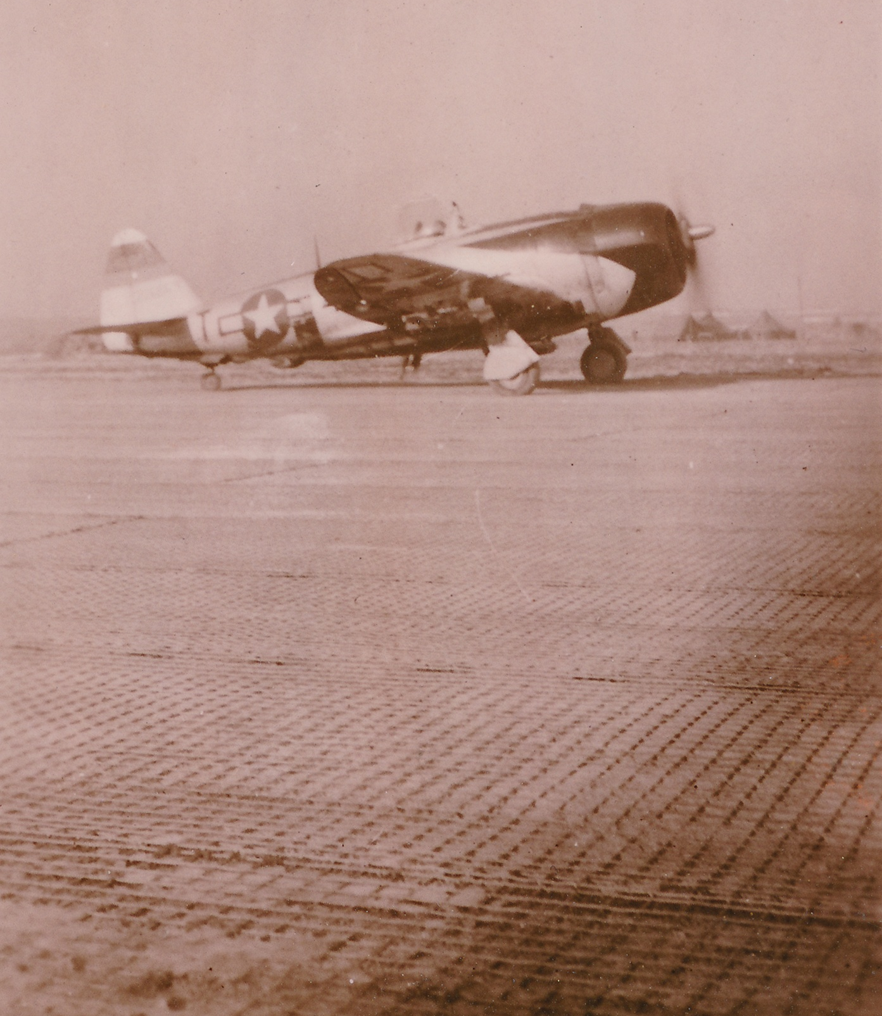
April 11, 1945 – 366 Fighter Group
April 15, 1945 – 406 Fighter Group
to Y-94 Munster (Germany)
Notes:
In April both Fighter Groups leaves the Y-29 for the Y-94 Munster in Germany

Slide 43
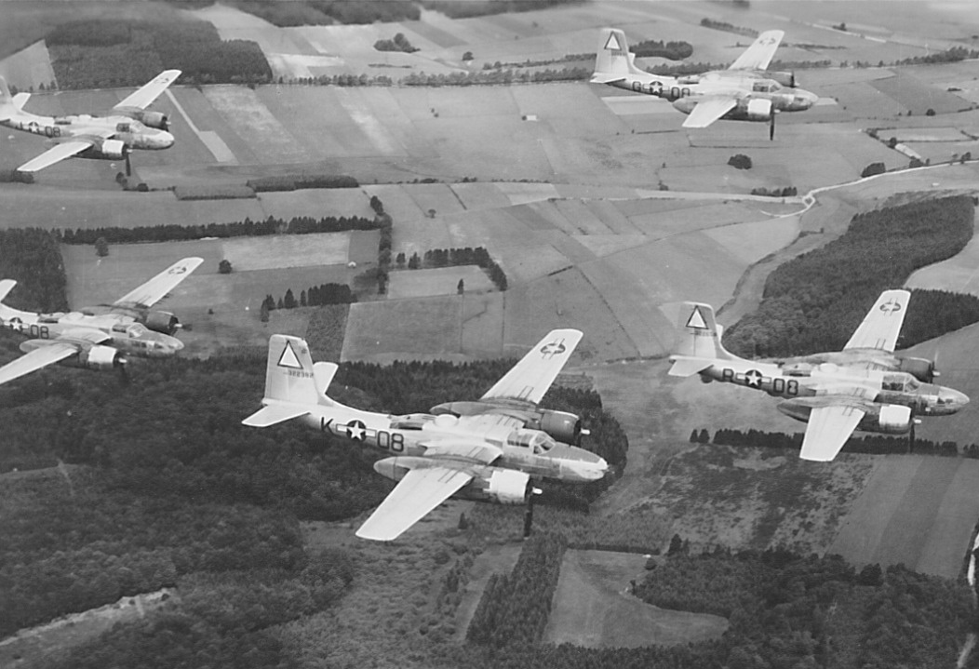
391 Bomber Group
Douglas A-26 Invader
April 16, 1945 – May 27, 1945
Notes:
Instead of the fighter groups came the 391 Bomber Group with 60 Douglas A-26 Invader light bombers.
In total, they flew 8 bombing missions from the Y-29.

Slide 44
May 8, 1945
End of
World War Two
in Europe
May 27, 1945
End of
the Y-29
Notes:
May 8, 1945: The end of World War Two in Europe.
May 27, 1945: end of the flight activities Y-29 and the Y-29 has been forested for the mining industry.
In 1954 the NATO airfield was constructed.

Slide 45
56 Allied soldiers killed
Notes:
56 Allied soldiers were killed while they were attached to the Y-29.

Slide 46
Notes:
31 soldiers are buried in American cemeteries such as Henri-Chapelle and Neupré (Belgium), Margraten (The Netherlands) and Luxembourg, …
20 fallen soldiers were brought to America to be buried there.
5 soldiers are still missing until today and are remembered on the "Tablets of the Missing".

Slide 47
Margraten, The Netherlands
Notes:
Edward Downs was initially buried in Margraten, The Netherlands.

Slide 48
Gracelawn Memorial Park, New Castle
Notes:
He was brought to America to be buried at the Gracelawn Memorial Park, New Castle.

Slide 49
Jan Lantmeeters
March 1, 2020
Notes:
Next on the program we are going to the beginning of the runway.
There is the memorial of the Y-29.

